Slide 1
DATAMITES - INTERNSHIP
PROJECT ID: PRDA-0 SUPPLY CHAIN ANALYSIS
PROJECT TEAM ID: PTID-CDA-OCT-25-814
Project By: SRAVANI BHAVANASI

Slide 2
Project Objective
Conduct an end-to-end diagnostic of SKU performance across the supply chain.
Evaluate demand flow, inventory health, production alignment, supplier dependability, and logistics spend.
Highlight operational bottlenecks impacting revenue, availability, and cost.
Provide strategic insights enabling optimized reorder cycles, supplier tiering, and logistics cost reduction.

Slide 3
DATASET OVERVIEW
A structured end-to-end supply chain dataset enabling performance analytics across products, suppliers, logistics, quality, and inventory.
Dataset composition
100+ skus across cosmetics, skincare, and haircare.
Multi-supplier sourcing network with varied lead times.
Complete supply chain attributes from production → delivery.
Key data fields
Product data: SKU, product type, price, availability.
Demand data: units sold, order quantity.

Slide 4
production & operations: production volume, processing time, lead time.
inventory metrics: stock levels, manufacturing cost.
supplier metrics: supplier ID, distance, lead time, reliability.
quality control: inspection results, defect rate (%).
logistics: transport mode, route, delivery time, shipping cost.
Purpose of the dataset
To evaluate revenue flow, inventory balance, supplier performance, quality stability, and logistics cost efficiency—supporting data-driven operational strategy.

Slide 5
KEY KPIs
Total Revenue: 577.6k
Products Sold: 46K units
Total Logistics Cost : 52.92k
Avg. Lead time: 15.96
Avg Defect rate : 2.277
Key insight: strong performance in skincare + top skus driving most sale.

Slide 6
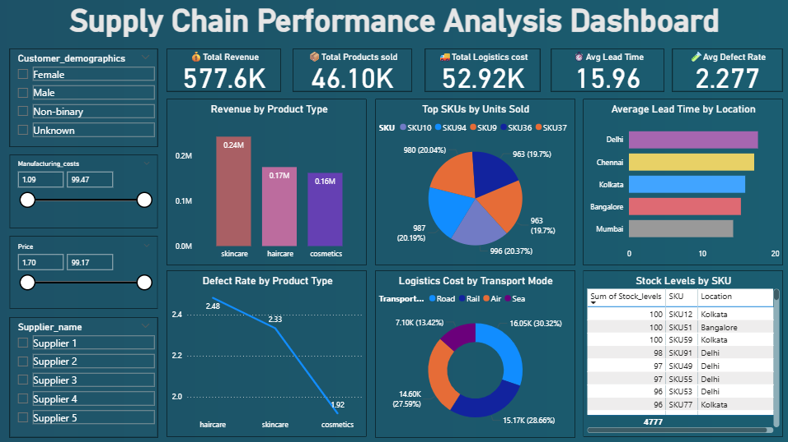
Dashboard Overview – POWER BI

Slide 7
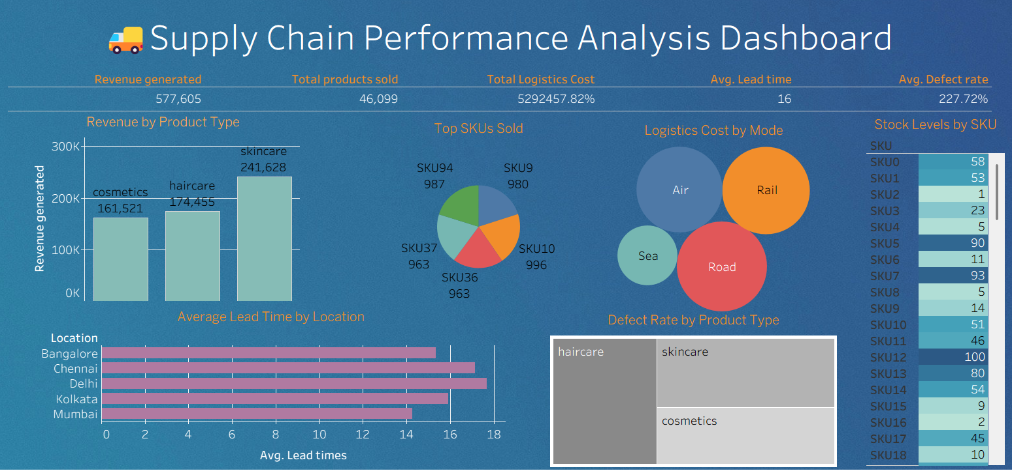
Dashboard Overview – TABLEAU

Slide 8
Revenue Performance by Product Type
Skincare: 241.6K (Highest)
Haircare: 174.4K
Cosmetics: 161.5K
📌 Skincare is the strongest revenue contributor. Focus on keeping its stock healthy.

Slide 9
PRODUCT MIX & CATEGORY INSIGHTS
skincare → highest demand + highest price point
haircare → stable middle performer
cosmetics → lower revenue but competitive volume
opportunity: expand skincare variants & bundle slower-moving cosmetic skus

Slide 10
Top 5 SKUs Sold
Top contributors:
SKU10: 996 units
SKU04: 987 units
SKU36 & SKU37: 963 units each
SKU09: 980 units
📌 Top five SKUs contribute major volume → Sales heavily rely on limited p

Slide 11
Lead Time Analysis
Highest delays:
Delhi ≈ 18 days
Chennai & Bangalore follow closely
📌 Longer lead time in major cities indicates logistical inefficiencies — needs optimization.

Slide 12
Logistics Cost by Mode
Road: 30.32% → Highest cost
Sea & Rail moderately lower
📌 Better mode allocation may reduce cost. Air can be used only for urgent shipments.

Slide 13
Defect Rate by Product Type
Haircare: Highest defect rate (~2.48%)
Cosmetics: Lowest (~1.92%)
📌 Quality issues mainly in Haircare — strengthen supplier QC.

Slide 14
Inventory Stock Levels
Some SKUs stocked high (SKU12 — 100 units)
Others extremely low (SKU2 — 1 unit, SKU8 — 5 units)
📌 Clear mismatch: Over-stocking some while others risk stockouts.

Slide 15
Customer DEMOGRAPHICS
Customer segments:
  Unknown: 0.83M
  Female: 0.49M
  Male: 0.49M
  Non-binary: 0.48M
key insight: high proportion of “unknown” customer data — requires cleansing for better marketing strategy.

Slide 16
Supplier-Wise Insights
Filter-based analysis (from dashboard dataset)
Identify suppliers causing long lead times
Top suppliers contributing to revenue
Recommendation: strengthen relationships with consistent suppliers to reduce average lead time

Slide 17
Key Findings
Skincare drives nearly half of revenue
Top 5 skus dominate overall sales
Customer demographic data incomplete — opportunity for data enhancement
Lead time averages ~16 days → room to optimize supply chain speed
Inventory management improvement needed for slow-moving skus

Slide 18
Recommendations
Optimize supply chain lead time
  Reduce delays from high-lead-time suppliers
Strengthen high-performing skus
  Increase stock for SKU10, SKU04, SKU36
Improve customer data capture
  Reduce “unknown” segment
Promotional strategy for low-revenue skus
  Bundle cosmetics and haircare for upselling
Forecasting & planning
  Implement demand forecasting using your dataset

Slide 19
Conclusion
Overall business performance strong.
Specific bottlenecks identified.
Clear strategies available for operational improvement.
Analysis supports data-driven decision making for supply chain optimization.

